Slide 1
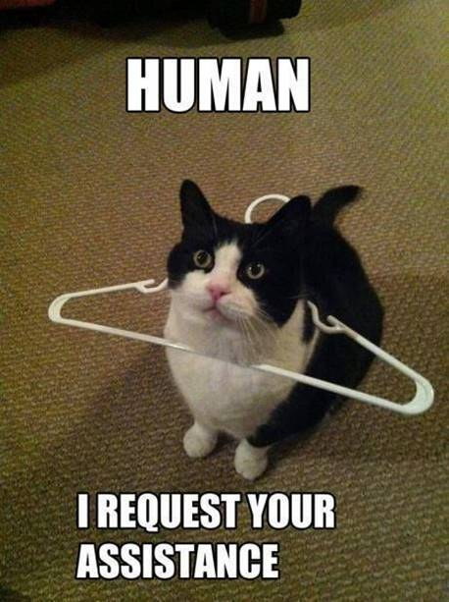
Timeline
Practice in your book
Practice on Studiemeter
Total Grammar Recap
Past
Future
Adverbs and Adjectives
Comparisons
Prepositions
Word order

Slide 2
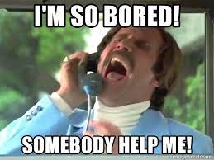
Practice in your book
Assignments
Check your planner – different for each level
Choose your own order
Ask for answer sheet

Slide 3
Practice on Studiemeter
How to use
Wikiwijs has instructions
Can Do MBO Breed audio + video belonging to book
Can Do Online vocab + expressions
First Aid Course grammar
Examencoach reading + listening
What to do
Look at planner
Plenty of practice possibilities

Slide 4
Total Grammar Recap
Topics
Past
Word order
Future
Adverbs and Adjectives
Comparisons
Prepositions
More sources
https://engelsklaslokaal.nl/
https://www.ego4u.com/en/cram-up/grammar

Slide 5
Past Simple and Present Perfect
Verleden tijd

Slide 6
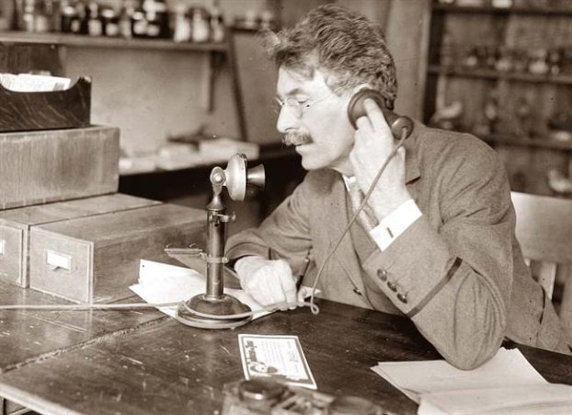
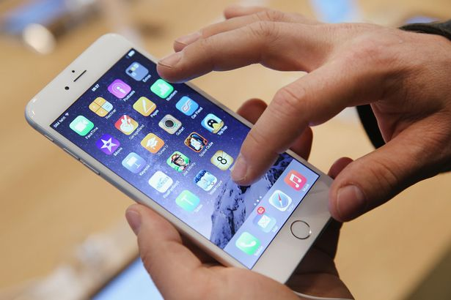
Past Tense
Past Present Future

Slide 7
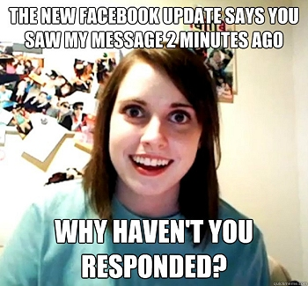
Present Perfect – Example
Past Simple
Present Perfect

Slide 8
Present Perfect – Example
Past Simple
Present Perfect

Slide 9
 | Past Simple Ik werkte | Present Perfect Ik heb gewerkt
When | Duidelijk wanneer het gebeurd is | Onduidelijk wanneer het gebeurd is
Rule | ww + ed | Have/ has + ww + ed
Uitzonderingen op de regel | Irregular verbs (onregelmatige ww.) zijn allemaal verschillend en moet je uit je hoofd leren. Krijg je op stencil.
How I | worked | have worked
You | worked | have worked
She / He / It | worked | has worked
We | worked | have worked
They | worked | have worked
Indicator | - Yesterday | - For
 | - In 1983 | - Yet
 | - Last week | - Never
 | - Three days ago | - Ever
 | - A minute ago | - Just
 | - When I was young | - Already
 |  | - Since
 |  | - Once
 |  | - Recently

Slide 10
Word order
Woord volgorde

Slide 11
Grammar: Woordvolgorde
Onderwerp | Werkwoordelijk gezegde (Ook PV dus) | Lijdend en/of meewerkend voorwerp | Bijwoordelijke bepaling: Waar | Bijwoordelijke bepaling: Wanneer
Wie of wat | Alle ww in de zin. | Wie of wat + WWG + OND | Plaats | Tijd
Wie/ wat doet wat in de zin gebeurd? | Wat doet het onderwerp? | Wie/ wat + WWG + OND? | Waar gebeurt het? | Wanneer gebeurt het?
Himani | lives |  | in Dublin
I | bought | a new phone |  | last month
She | ‘ll be |  | here | tomorrow
I | went |  | home | at eight o’clock
He | bought | a phone | at Harrods | last week

Slide 12
Future
Toekomst

Slide 13
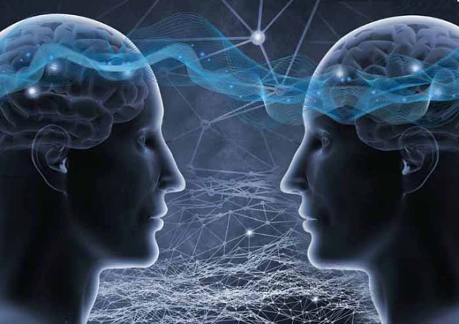
Future tense
Going to
Will
Future

Slide 14
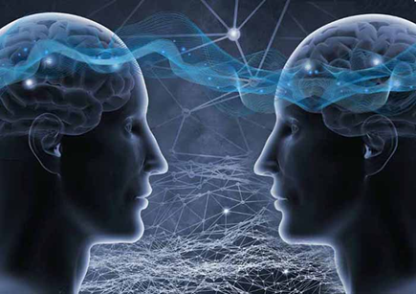
Am / Are / Is going to
When
Staat vast. Gaat zeker gebeuren.
Indicator
Certainly
No doubt
Sure to happen
Definitely
Absolutely
Rule
Am / Are / Is going to
How
I am going to work
You are going to work
She/ He/ It is going to work
We are going to work
They are going to work

Slide 15
Will or Shall
When
Will: Van plan. Onzeker of het zal gebeuren.
Shall: Alleen bij vragende zinnen en alleen als ‘I’ of ‘We’ het onderwerp is.
Indicator
I think...
Probably
Sometime
Once
Maybe
Rule
Will / Shall + ww
How
I will work
You will work
She/ He/ It will work
We will work
They will work
Shall I work tomorrow?
Will you work tomorrow?
Will she/he/it work tomorrow?
Shall we work tomorrow?
Will they work tomorrow?

Slide 16
Adverbs and Adjectives
Bijwoorden en Bijvoeglijk Naamwoorden

Slide 17
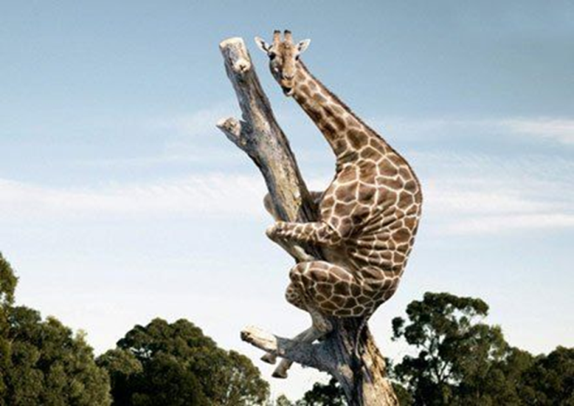
Grammar – Beschrijven
Fearful
Timmy is a fearful giraffe.
He holds on to the tree fearfully.

Slide 18
Fearful
Timmy is a fearful giraffe.
He holds on to the tree fearfully.
Iets of iemand
Actie

Slide 19
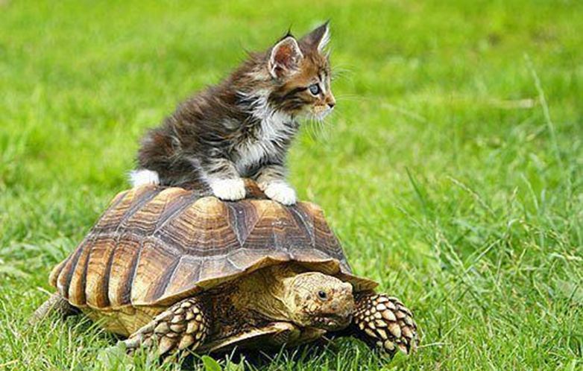
Slow
Thom is a ________ turtle.
He walks home _________.
Iets of iemand
Actie

Slide 20
Slow
Thom is a _slow_ turtle.
He walks home _________.
Iets of iemand
Actie

Slide 21
Slow
Thom is a _slow_ turtle.
He walks home _slowly_.
Iets of iemand
Actie

Slide 22
Grammar – Beschrijven
Bijvoegelijke naamwoorden (Adjectives) en Bijwoorden (Adverbs)
Zelfstandig naamwoord
= woorden waar je de, het of een voor kunt zetten
= woorden waar je a of an voor kunt zetten in het Engels
 | When Zegt iets over… | Rule | Signaalwoord
Bijvoeglijk naamwoord | Iets of iemand | Woord | Zelfstandig naamwoord
Bijwoord | Actie | Woord + ly | Werkwoord

Slide 23
Comparisson
Vergelijking

Slide 24
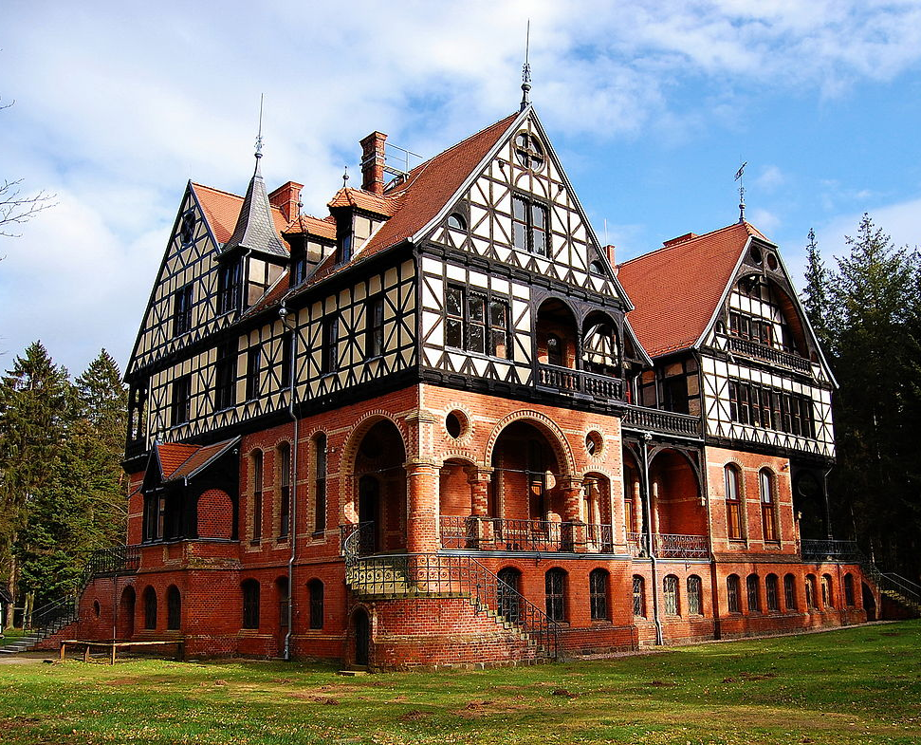
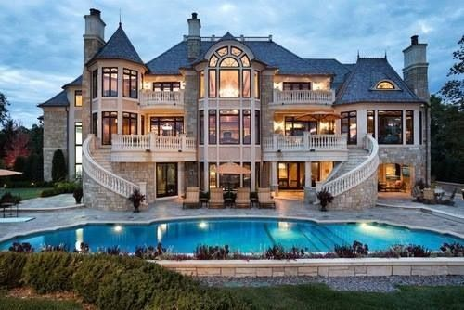
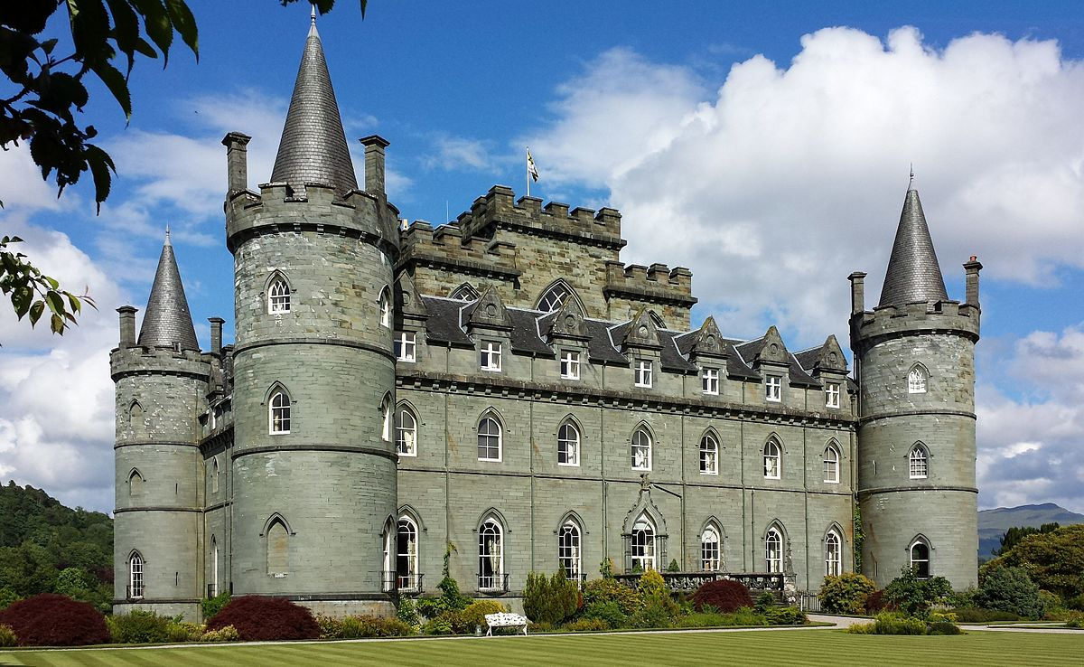
Grammar Comparisons
BIG BIGGER BIGGEST
Comparison = Vergelijken
Explanation on the next slides
Practice on Studiemeter
For additional practice: Watch the clip on YouTube

Slide 25
Grammar Comparisons
BIG BIGGER BIGGEST
Comparison = Vergelijken
Uitleg op de volgende slides
Oefenen op Studiemeter
Voor extra oefening: kijk de clip op YouTube

Slide 26
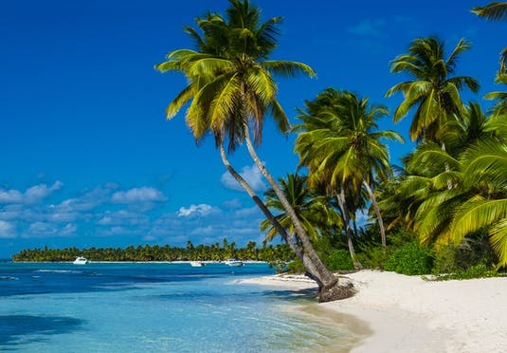
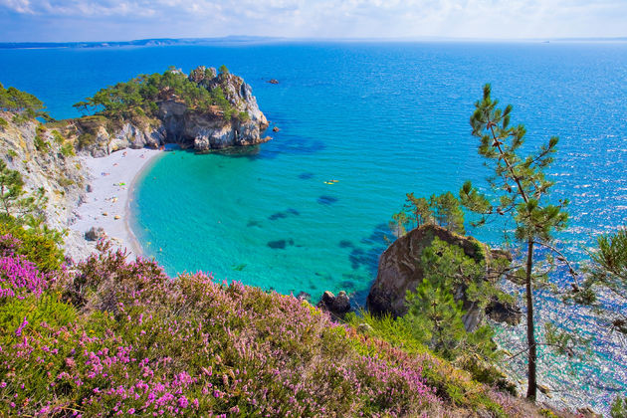
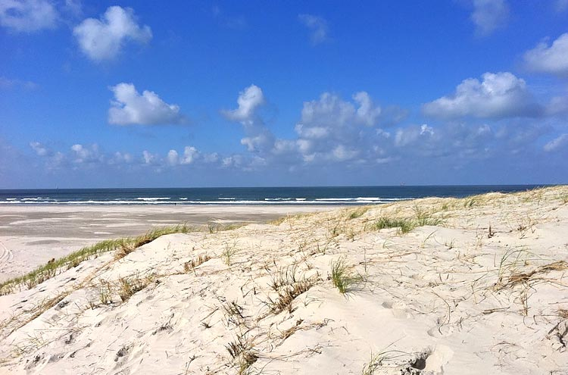
Grammar Comparisons
Mooist
Overtreffende trap
Mooier Superlative degree
Vergrotende trap
Mooi Comparative degree
Basis (stellende) trap
Positive degree

Slide 27
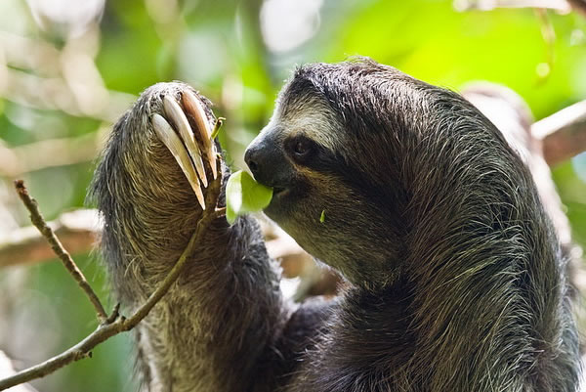
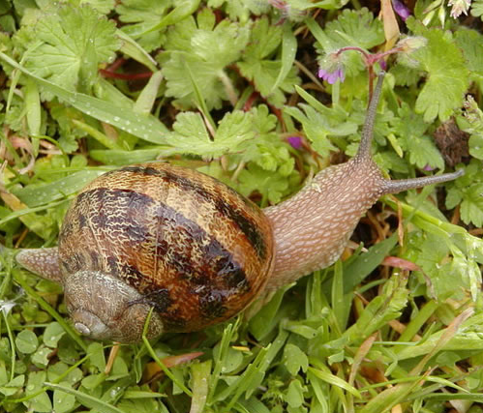
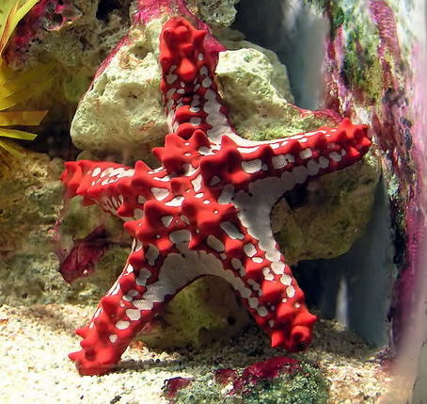
Grammar Comparisons
Slow
Sloth (o.003 m/h)
Garden snail (0,03 m/h)
Starfish (o,o6)
Overtreffende trap
Superlative degree
Vergrotende trap
Comparative degree
Basis (stellende) trap
Positive degree
Slow Slower Slowest

Slide 28
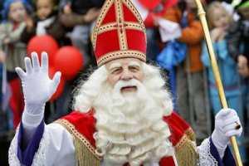
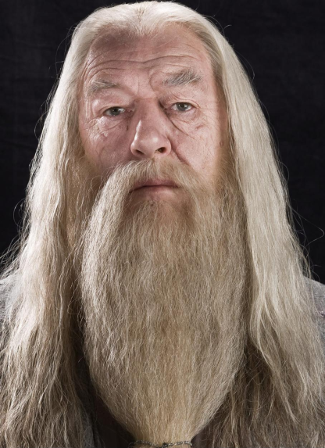
Grammar Comparisons
Old
Overtreffende trap
Superlative degree
Vergrotende trap
Comparative degree
Basis (stellende) trap
Positive degree
Old Older Oldest

Slide 29
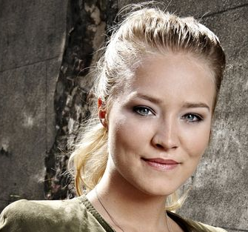
Grammar Comparisons
Pretty
(according to 50 Cent)
Overtreffende trap
Superlative degree
Vergrotende trap
Comparative degree
Basis (stellende) trap
Positive degree
Pretty Prettier Prettiest

Slide 30
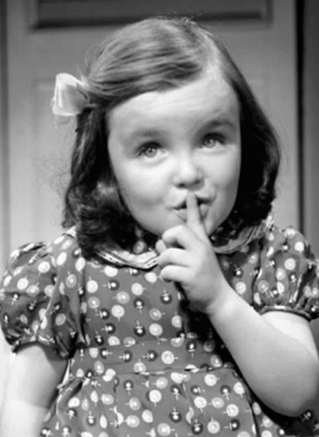
Grammar Comparisons
Quiet
Overtreffende trap
Superlative degree
Vergrotende trap
Comparative degree
Basis (stellende) trap
Positive degree
Quiet Quieter / More Quiet Quietest / Most Quiet

Slide 31
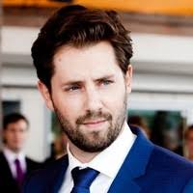
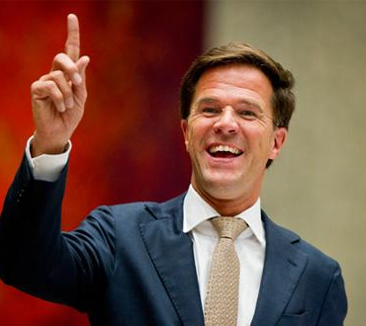
Grammar Comparisons
Powerful
Overtreffende trap
Superlative degree
Vergrotende trap
Comparative degree
Basis (stellende) trap
Positive degree
Powerful More powerful Most powerful

Slide 32
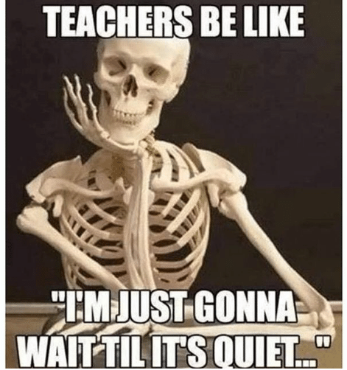
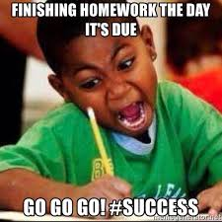
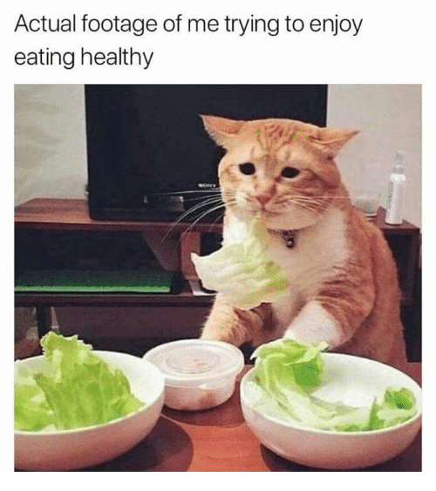
Grammar Comparisons
Difficult
Overtreffende trap
Superlative degree
Vergrotende trap
Comparative degree
Basis (stellende) trap
Positive degree
Difficult More difficult Most difficult

Slide 33
Grammar Comparisons
Degrees of comparison
Trappen van vergelijking
Woorden met 1 lettergreep + er +est
Woorden met 2 lettergrepen + er / more + est/ most
Woorden met 3 (+) lettergrepen + more + most
Oldest / Prettiest / Most powerful
Older / Prettier / More powerful Overtreffende trap
Superlative degree
Vergrotende trap
Old / Pretty / Powerful Comparative degree
Basis (stellende) trap
Positive degree

Slide 34
Grammar Comparisons
Exceptions to the rule
Uitzonderingen op de regel
Good – Better – Best
Bad – Worse – Worst

Slide 35
Prepositions
Voorzetsels

Slide 36
Prepositions - Voorzetsels
Give me examples of prepositions please

Slide 37
Prepositions - Voorzetsels
What are prepositions?
Place
Direction
Time
In andere woorden:
Waar iets is
Welke kant het op gaat
Wanneer iets gebeurd

Slide 38
Prepositions – Voorzetsels
Exercise A
You already know many prepositions
Underline the ones in the sentences
Take 2 minutes then we check them

Slide 39
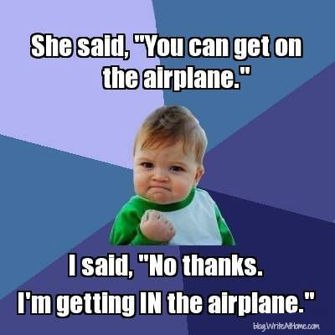
Prepositions – Voorzetsels
Explanation
Learn by heart
Not always just a translation
Silly mistakes!
Practice online
https://www.ego4u.com/en/cram-up/grammar/prepositions

